Slide 1
Data Analysis for credit one
By Smitha Palampalli
Course 2 Task 1

Slide 2

Business goal
The business goal of this data analysis effort is to determine if there are any factors which influence or can help predict if a customer will default on their payment.

Slide 3
Data Science Framework
With this effort we will be following the Zumel and Mount framework. The steps followed within this framework are
Define the Business Goal
Collect and Manage Data
Build the Model
Evaluate the Model
Share the Results
Deploy and Maintain the Model

Slide 4
WHY ZUMEL AND MOUNT
The reason we plan to follow this framework is because we have a well-defined business goal with this project. We also have that dataset already available for us to use for analysis.
Since we have the data provided to us (as opposed to us collecting it from various sources), we do not have enough familiarity with the data at the get-go to define an analysis plan right away.
Working with the data while preprocessing and modelling will help us get familiar with the data parallelly while defining the analysis goals. This will help us with modelling the data.

Slide 5
Data Source
The data we will be using for analysis is located on Credit One’s database.
This data will be loaded into Python Pandas data-frame by connecting to the database. A Pandas data-frame provides the ability to house data from database table in Python.
The data can also be exported into an excel file.
From here on the data from the data-frame will be used for analysis and modelling.

Slide 6
Credit metrics
We have a little over 30,000 records of customer information. The data has the following demographic and payment information for each customer:
Credit Balance
Gender
Education
Marital Status
Age
Payment History for the last 6 months - whether full partial or no payment was made
Bill Amount for the last 6 months
Payment Amount for the last 6 months
Client’s Payment Default status in the current month

Slide 7
Preprocessing of Data
Preprocessing of data will be done to identify and handle any issues with data.
Data will be examined to look for any duplicate values. Duplicates will be removed such that only one instance of the duplicate observation will be retained for analysis.
Any observations with missing values will be dropped from the dataset, so as to not skew the analysis. We are not seeing a lot of missing values.
Data will also be converted into a usable numerical format as most data analysis models perform better with numerical data as opposed to textual data.

Slide 8
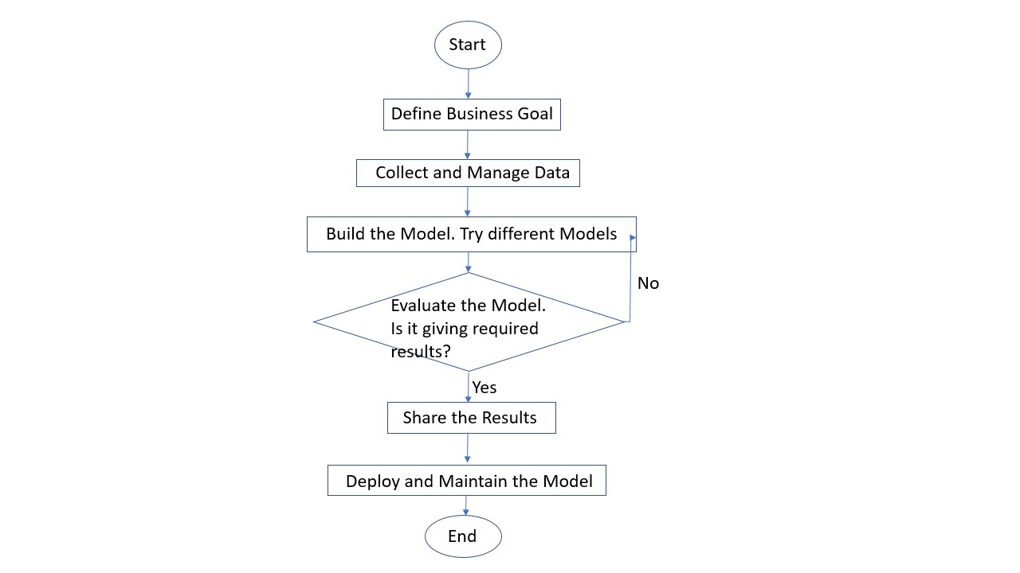
Flowchart of the Data Science Process

Slide 9
Initial Insights:
We have more female customers than male
Most customers are university educated
Most customers are between 25-35 years of age

